Slide 1
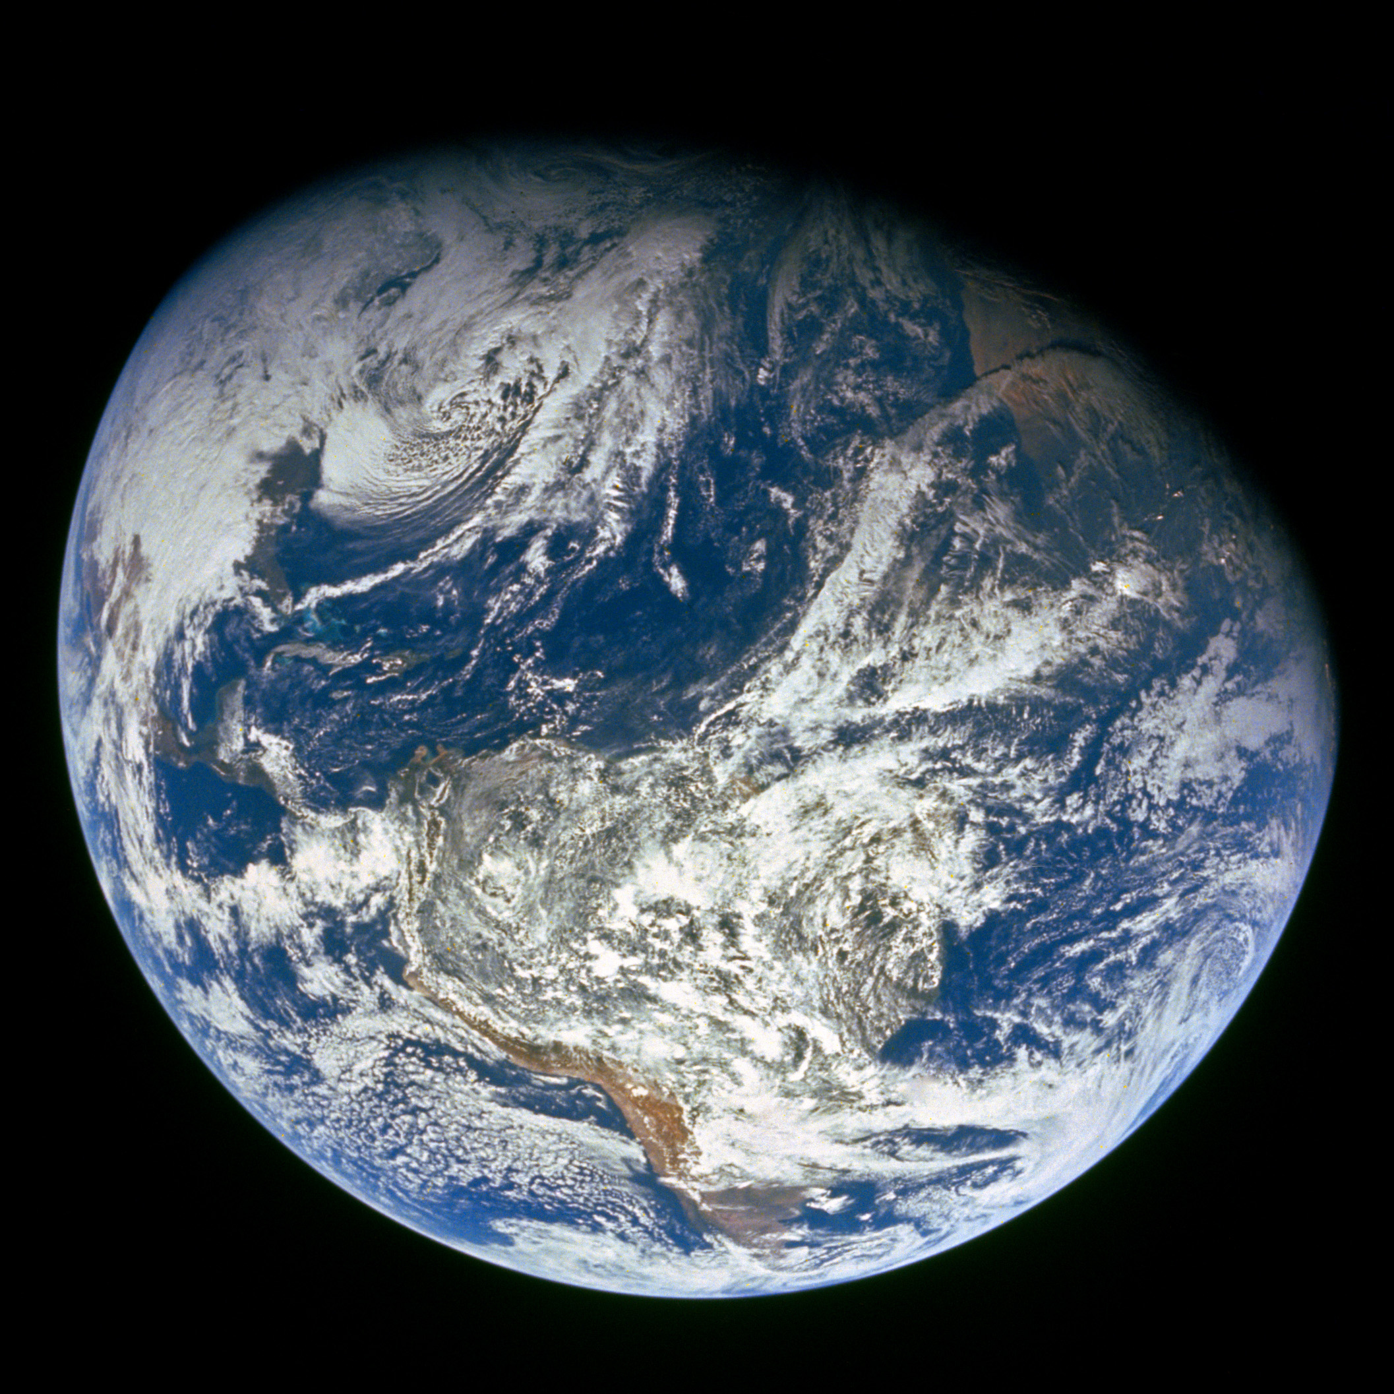
GENESIS
”In the beginning God…”

Slide 2
Four year study of the Bible - 17 Periods
Genesis to United Kingdom
Year 1
United Kingdom to Years of Silence
Year 2
Life of Christ to Paul’s 1st Journey
Year 3
Paul’s 2nd Journey thru the Epistles
Year 4

Slide 3
Our study this quarter (Genesis)
Quarter 1 (Genesis)
1)
2)
3)
4)
5)
6)
7)
8)
9)
Before The Flood
The Flood
The Scattering Of The People
The Patriarchs
The Exodus
The Wandering In The Wilderness
Invasion & Conquest
Judges
United Kingdom
10)
11)
12)
13)
14)
15)
16)
17)
Divided Kingdom
Judah Alone
Captivity
Return From Captivity
Years Of Silence
Life Of Christ
The Early Church
The Letters To The Christians

Slide 4
Next quarter (Exodus – Deuteronomy)
1)
2)
3)
4)
5)
6)
7)
8)
9)
Before The Flood
The Flood
The Scattering Of The People
The Patriarchs
The Exodus
The Wandering In The Wilderness
Invasion & Conquest
Judges
United Kingdom
10)
11)
12)
13)
14)
15)
16)
17)
Divided Kingdom
Judah Alone
Captivity
Return From Captivity
Years Of Silence
Life Of Christ
The Early Church
The Letters To The Christians
Quarter 2 (Exodus – Deuteronomy)

Slide 5
The “sum of thy word is truth” (Psalm 119:160 ASV) – we get understanding of God’s will by taking all that God has to say on a subject.
Long ago when I was in college, I didn’t have Google, so I went to the library and checked out different textbooks on a subject. I did that in order to see different example problems on the same subject matter. If we want to understand more about Genesis, go to God’s library and check out different books in the Bible.

Slide 6
Some select external passages that provide more insight into Genesis:
Psalm 105 (Joseph)
Acts 7 (Patriarchs)
Romans 9:4-13 (Jacob and Esau)
Hebrews 11 (their faith)
James 2:21-24 (Abraham)
2 Peter 2:5-9 (Noah and Lot)
Hebrews 12:16-17 (Esau)
Jude 7 (Sodom and Gomorrah)

Slide 7
For example:
Hebrews 11 and James 2 give us more insight into the faith of those we read about in Genesis.
2 Peter 2:5-9 tells us more about Lot. If the only thing we knew of Lot was from Genesis, we might not see the power of Lot’s example.
We see some select events in Lots life, but then from Peter, we see what God thought when he looked back on Lot. God shows that Lot was: just, righteous, had a righteous soul, and was godly. And that God delivered Lot from his temptations.
We see that someone sins (e.g. Judah), but then we see them go on to perfection.
Jude 7 shows us that Sodom gave themselves over to fornication (they were gluttons for fornication) and perversion, they weren’t simply “inhospitable.”

Slide 8
Three Points in Review of Genesis
The Power of God
The Promises of God
By Grace Through Faith

Slide 9
1) The Power of God
a) Creation
“God said”
[Hebrews 11:3 KJV] 3 Through faith we understand that the worlds were framed by the word of God, so that things which are seen were not made of things which do appear.
“in six days” I take it that God drew things out in six days and rested the seventh for a purpose.
[Exodus 20:11 KJV] 11 For [in] six days the LORD made heaven and earth, the sea, and all that in them [is], and rested the seventh day: wherefore the LORD blessed the sabbath day, and hallowed it.
[Mark 10:6 KJV] 6 But from the beginning of the creation God made them male and female.

Slide 10
1) The Power of God
a) Creation
Made woman from man. God performed the first surgical operation we know, and took a rib from Adam to make woman.
[Genesis 2:21-23 KJV] 21 And the LORD God caused a deep sleep to fall upon Adam, and he slept: and he took one of his ribs, and closed up the flesh instead thereof; 22 And the rib, which the LORD God had taken from man, made he a woman, and brought her unto the man. 23 And Adam said, This [is] now bone of my bones, and flesh of my flesh: she shall be called Woman, because she was taken out of Man.

Slide 11
1) The Power of God
b) Flood
God brought the flood of water upon the earth.
[Genesis 6:17 KJV] 17 And, behold, I, even I, do bring a flood of waters upon the earth, to destroy all flesh, wherein [is] the breath of life, from under heaven; [and] every thing that [is] in the earth shall die.
[Genesis 7:11 KJV] 11 In the six hundredth year of Noah's life, in the second month, the seventeenth day of the month, the same day were all the fountains of the great deep broken up, and the windows of heaven were opened.
God stopped and restrained the flood
[Genesis 8:1-2 KJV] 1 And God remembered Noah, and every living thing, and all the cattle that [was] with him in the ark: and God made a wind to pass over the earth, and the waters asswaged; 2 The fountains also of the deep and the windows of heaven were stopped, and the rain from heaven was restrained;

Slide 12
1) The Power of God
b) Flood
God put the fear of man into beasts
[Genesis 9:2-3 KJV] 2 And the fear of you and the dread of you shall be upon every beast of the earth, and upon every fowl of the air, upon all that moveth [upon] the earth, and upon all the fishes of the sea; into your hand are they delivered. 3 Every moving thing that liveth shall be meat for you; even as the green herb have I given you all things.
God set a bow in the clouds. Consider that just as we see the bow, God is looking at it remembering his promise.
[Genesis 9:13-16 KJV] 13 I do set my bow in the cloud, and it shall be for a token of a covenant between me and the earth. 14 And it shall come to pass, when I bring a cloud over the earth, that the bow shall be seen in the cloud: 15 And I will remember my covenant, which [is] between me and you and every living creature of all flesh; and the waters shall no more become a flood to destroy all flesh. 16 And the bow shall be in the cloud; and I will look upon it, that I may remember the everlasting covenant between God and every living creature of all flesh that [is] upon the earth.

Slide 13
1) The Power of God
c) Babel – God confounded their language
[Genesis 11:7-8 KJV] 7 Go to, let us go down, and there confound their language, that they may not understand one another's speech. 8 So the LORD scattered them abroad from thence upon the face of all the earth: and they left off to build the city.

Slide 14
1) The Power of God
d) Sodom – God’s vengeance against them
[Genesis 19:23-26 KJV] 23 The sun was risen upon the earth when Lot entered into Zoar. 24 Then the LORD rained upon Sodom and upon Gomorrah brimstone and fire from the LORD out of heaven; 25 And he overthrew those cities, and all the plain, and all the inhabitants of the cities, and that which grew upon the ground. 26 But his wife looked back from behind him, and she became a pillar of salt.

Slide 15
1) The Power of God
e) God protected Jacob
[Genesis 31:7-12 KJV] 7 And your father hath deceived me, and changed my wages ten times; but God suffered him not to hurt me. 8 If he said thus, The speckled shall be thy wages; then all the cattle bare speckled: and if he said thus, The ringstraked shall be thy hire; then bare all the cattle ringstraked. 9 Thus God hath taken away the cattle of your father, and given [them] to me. 10 And it came to pass at the time that the cattle conceived, that I lifted up mine eyes, and saw in a dream, and, behold, the rams which leaped upon the cattle [were] ringstraked, speckled, and grisled. 11 And the angel of God spake unto me in a dream, [saying], Jacob: And I said, Here [am] I. 12 And he said, Lift up now thine eyes, and see, all the rams which leap upon the cattle [are] ringstraked, speckled, and grisled: for I have seen all that Laban doeth unto thee.

Slide 16
1) The Power of God
f) God protected Joseph
[Genesis 39:2-3, 21-23 KJV] 2 And the LORD was with Joseph, and he was a prosperous man; and he was in the house of his master the Egyptian. 3 And his master saw that the LORD [was] with him, and that the LORD made all that he did to prosper in his hand. ... 21 But the LORD was with Joseph, and shewed him mercy, and gave him favour in the sight of the keeper of the prison. 22 And the keeper of the prison committed to Joseph's hand all the prisoners that [were] in the prison; and whatsoever they did there, he was the doer [of it]. 23 The keeper of the prison looked not to any thing [that was] under his hand; because the LORD was with him, and [that] which he did, the LORD made [it] to prosper.

Slide 17
1) The Power of God
g) God sent the famine of Joseph’s day
God called for a famine upon the land
[Psalm 105:16-17 KJV] 16 Moreover he called for a famine upon the land: he brake the whole staff of bread. 17 He sent a man before them, [even] Joseph, [who] was sold for a servant:
God sent Joseph
[Genesis 45:7-8 KJV] 7 And God sent me before you to preserve you a posterity in the earth, and to save your lives by a great deliverance. 8 So now [it was] not you [that] sent me hither, but God: and he hath made me a father to Pharaoh, and lord of all his house, and a ruler throughout all the land of Egypt.
[Genesis 50:20 KJV] 20 But as for you, ye thought evil against me; [but] God meant it unto good, to bring to pass, as [it is] this day, to save much people alive.

Slide 18
2) The Promises of God to Abraham
a) Make him a great nation
[Genesis 17:3-6 KJV] 3 And Abram fell on his face: and God talked with him, saying, 4 As for me, behold, my covenant [is] with thee, and thou shalt be a father of many nations. 5 Neither shall thy name any more be called Abram, but thy name shall be Abraham; for a father of many nations have I made thee. 6 And I will make thee exceeding fruitful, and I will make nations of thee, and kings shall come out of thee.
[Genesis 15:5 KJV] 5 And he brought him forth abroad, and said, Look now toward heaven, and tell the stars, if thou be able to number them: and he said unto him, So shall thy seed be.

Slide 19
2) The Promises of God to Abraham
b) Give him the land of Canaan
[Genesis 17:8 KJV] 8 And I will give unto thee, and to thy seed after thee, the land wherein thou art a stranger, all the land of Canaan, for an everlasting possession; and I will be their God.
c) There would be a time that his descendants would be slaves, but in the fourth generation they would return to Canaan.
[Genesis 15:13-16 KJV] 13 And he said unto Abram, Know of a surety that thy seed shall be a stranger in a land [that is] not theirs, and shall serve them; and they shall afflict them four hundred years; 14 And also that nation, whom they shall serve, will I judge: and afterward shall they come out with great substance. 15 And thou shalt go to thy fathers in peace; thou shalt be buried in a good old age. 16 But in the fourth generation they shall come hither again: for the iniquity of the Amorites [is] not yet full.

Slide 20
2) The Promises of God to Abraham
d) Bless all nations through him
[Genesis 12:1-3 KJV] 1 Now the LORD had said unto Abram, Get thee out of thy country, and from thy kindred, and from thy father's house, unto a land that I will shew thee: 2 And I will make of thee a great nation, and I will bless thee, and make thy name great; and thou shalt be a blessing: 3 And I will bless them that bless thee, and curse him that curseth thee: and in thee shall all families of the earth be blessed.

Slide 21
2) The Promises of God to Abraham
e) The blessing to all nations would come through Abraham’s son Isaac.
[Romans 9:4-13 KJV] 4 Who are Israelites; to whom [pertaineth] the adoption, and the glory, and the covenants, and the giving of the law, and the service [of God], and the promises; 5 Whose [are] the fathers, and of whom as concerning the flesh Christ [came], who is over all, God blessed for ever. Amen. 6 Not as though the word of God hath taken none effect. For they [are] not all Israel, which are of Israel: 7 Neither, because they are the seed of Abraham, [are they] all children: but, In Isaac shall thy seed be called. 8 That is, They which are the children of the flesh, these [are] not the children of God: but the children of the promise are counted for the seed. 9 For this [is] the word of promise, At this time will I come, and Sara shall have a son.

Slide 22
2) The Promises of God to Abraham
[Genesis 17:19-21 KJV] 19 And God said, Sarah thy wife shall bear thee a son indeed; and thou shalt call his name Isaac: and I will establish my covenant with him for an everlasting covenant, [and] with his seed after him. 20 And as for Ishmael, I have heard thee: Behold, I have blessed him, and will make him fruitful, and will multiply him exceedingly; twelve princes shall he beget, and I will make him a great nation. 21 But my covenant will I establish with Isaac, which Sarah shall bear unto thee at this set time in the next year.
[Genesis 21:1-2, 13 KJV] 1 And the LORD visited Sarah as he had said, and the LORD did unto Sarah as he had spoken. 2 For Sarah conceived, and bare Abraham a son in his old age, at the set time of which God had spoken to him. ... 13 And also of the son of the bondwoman will I make a nation, because he [is] thy seed.
[Acts 3:25-26 KJV] 25 Ye are the children of the prophets, and of the covenant which God made with our fathers, saying unto Abraham, And in thy seed shall all the kindreds of the earth be blessed. 26 Unto you first God, having raised up his Son Jesus, sent him to bless you, in turning away every one of you from his iniquities.

Slide 23
2) The Promises of God to Abraham
e) The blessing to all nations would come through Abraham’s son Isaac.
[Romans 9:4-13 KJV] 10 And not only [this]; but when Rebecca also had conceived by one, [even] by our father Isaac; 11 (For [the children] being not yet born, neither having done any good or evil, that the purpose of God according to election might stand, not of works, but of him that calleth;) 12 It was said unto her, The elder shall serve the younger. 13 As it is written, Jacob have I loved, but Esau have I hated.
[Genesis 25:23 KJV] 23 And the LORD said unto her, Two nations [are] in thy womb, and two manner of people shall be separated from thy bowels; and [the one] people shall be stronger than [the other] people; and the elder shall serve the younger.

Slide 24
Introduction: The Bible Story
The Bible is not a series of unconnected “once-upon-a-time” stories. It is the unfolding of a beautiful, eternal plan God made for the redemption of mankind. All the stories fit together to form one beautiful whole. -- Bob & Sandra Waldron “In The Beginning, God…” [p. 1]

Slide 25
3) By Grace Through Faith
a) Whether you’re Abraham, or the last man on earth – salvation from sin is by grace through faith. Jesus’ blood is the means by which all men are cleansed (Romans 3:25).
b) Consider Romans 4
[Romans 4:1-8 KJV] 1 What shall we say then that Abraham our father, as pertaining to the flesh, hath found? 2 For if Abraham were justified by works, he hath [whereof] to glory; but not before God. 3 For what saith the scripture? Abraham believed God, and it was counted unto him for righteousness. 4 Now to him that worketh is the reward not reckoned of grace, but of debt. 5 But to him that worketh not, but believeth on him that justifieth the ungodly, his faith is counted for righteousness. 6 Even as David also describeth the blessedness of the man, unto whom God imputeth righteousness without works, 7 [Saying], Blessed [are] they whose iniquities are forgiven, and whose sins are covered. 8 Blessed [is] the man to whom the Lord will not impute sin.

Slide 26
3) By Grace Through Faith
Paul contrasts two systems of salvation – 1) grace, 2) debt Romans 4:4
He uses two people to illustrate his point – 1) Abraham, 2) David
We’ve missed the avenue of debt, because we have sinned. Romans 3:23 Sin separates man from God.
[Genesis 2:17 KJV] 17 But of the tree of the knowledge of good and evil, thou shalt not eat of it: for in the day that thou eatest thereof thou shalt surely die.
[Ezekiel 18:20-21 KJV] 20 The soul that sinneth, it shall die. The son shall not bear the iniquity of the father, neither shall the father bear the iniquity of the son: the righteousness of the righteous shall be upon him, and the wickedness of the wicked shall be upon him. 21 But if the wicked will turn from all his sins that he hath committed, and keep all my statutes, and do that which is lawful and right, he shall surely live, he shall not die.

Slide 27
3) By Grace Through Faith
We need the avenue of grace, God’s willingness to forgive our sins by the blood of Christ.
But the condition of salvation by grace is faith. The just shall live by faith. Romans 1:17 / Habakkuk 2:4 Living by faith simply means we do what God told us to do.
[John 8:31-32 KJV] 31 Then said Jesus to those Jews which believed on him, If ye continue in my word, [then] are ye my disciples indeed; 32 And ye shall know the truth, and the truth shall make you free.
[John 14:15, 23 KJV] 15 If ye love me, keep my commandments. ... 23 Jesus answered and said unto him, If a man love me, he will keep my words: and my Father will love him, and we will come unto him, and make our abode with him.
[Hebrews 5:8-9 KJV] 8 Though he were a Son, yet learned he obedience by the things which he suffered; 9 And being made perfect, he became the author of eternal salvation unto all them that obey him;

Slide 28
3) By Grace Through Faith
c) God’s grace is what allows man to be declared righteous through faith. Begin reading Hebrews 10:38 through 11:1-22. Notice that those who are righteous are righteous by the obedience of their faith (10:38).

Slide 29
3) By Grace Through Faith
c) God’s grace is what allows man to be declared righteous through faith. Begin reading Hebrews 10:38 through 11:1-22. Notice that those who are righteous are righteous by the obedience of their faith (10:38).
Yes, these sinned, but from Romans 4 we see they could be forgiven by grace through faith. We can be forgiven by grace through our faith.
[Hebrews 12:1-2 KJV] 1 Wherefore seeing we also are compassed about with so great a cloud of witnesses, let us lay aside every weight, and the sin which doth so easily beset [us], and let us run with patience the race that is set before us, 2 Looking unto Jesus the author and finisher of [our] faith; who for the joy that was set before him endured the cross, despising the shame, and is set down at the right hand of the throne of God.

Slide 30
d. While the pattern of by grace through faith is the same for us as with Abraham, our conditions of faith are different. That’s what trips people up sometimes. Someone says, we don’t have to be baptized because the thief on the cross was not baptized. It’s true that the thief was not subject to Mark 16:16, but he wasn’t subject to it any more than Abraham was. But we are subject to Mark 16:16, so if we are going to live by faith, we’re going to have to surrender obedience to everything the gospel of Christ teaches us.
3) By Grace Through Faith
d) While the pattern of by grace through faith is the same for us as for Abraham, our conditions of faith are different. That’s what trips people up. Someone says, “we don’t have to be baptized because the thief on the cross was not baptized.” It’s true that the thief was not subject to Mark 16:16, but he wasn’t subject to it any more than Abraham was. But we are subject to Mark 16:16, so if we are going to live by faith, we’re going to have to surrender obedience to everything the gospel of Christ teaches us, just as Abraham lived by what God told him. The just shall live by faith!

